Slide 1
Lecture 5:
Themes in Indian Environmentalism - II
Course: Environment and Politics in India

Slide 2
Agrarian Change/Forest Transformation
    Criminalizing lack of “means of production”:
    The Criminal Tribes Act (CTA) was used against “wandering groups, nomadic petty traders and pastoralists, gypsy types, hilland forest-dwelling tribals, in short, against a wide variety of marginals who did not conform to the colonial pattern of settled agricultural and wage labour” – David Arnold
Amendments in the CTA from 1871 to 1911:
“The needs of practical governance led to a search for a ‘social scientiﬁc’ explanation of crime in India, connecting Indian criminality to the introduction of the railways, the new forest policy, repeated famines and so on” - Meena Radhakrishna

Slide 3
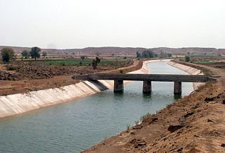
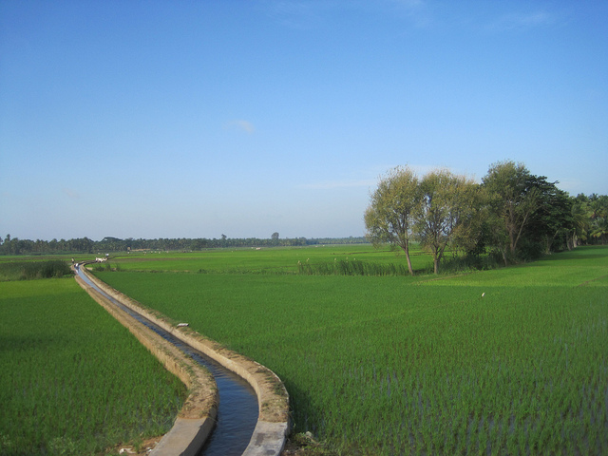

Slide 4
Agrarian Change/Forest Transformation
  IMPACT of canal irrigation:
  Introduced by the British to extend settled agriculture.
  Vast grazing grounds termed as ‘waste lands’ with no ‘rational’ economic activity. Varying conceptions of man-nature relationships.
  Imperial State as agent of social/economic/ecological change.
  Growth in output, net cultivated area, volume of trade, net revenue returns.
  Displacement of older systems of pastoral production and dryland farming:
    Over-cropping
    Salination
    Destruction of wells/tanks
    Percolation of main channel, leading to creation of swamps

Slide 5
Agrarian Change/Forest Transformation
  IMPACT of canal irrigation:
  Waterlogging -> falling agricultural returns, diseases and disability .
  No emphasis on ecological specificities (knowledge of rain catchment, inundation, drainage) -> waterlogging, salinity, silt, DESTRUCTION of natural drainage through construction of embankments. EXAMPLE: Kosi.
  NEW lands available for settlement. Allotment to dominant landowning castes/classes -> more rigidity of social structures.
  Changing of social structures/patterns:
    Contraction of grazing grounds
    Destruction/marginalization of nomadic/semi-nomadic/pastoral tribes and cattle/camel/horse rearing.

Slide 6
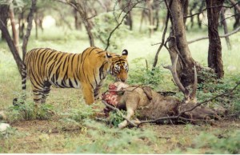
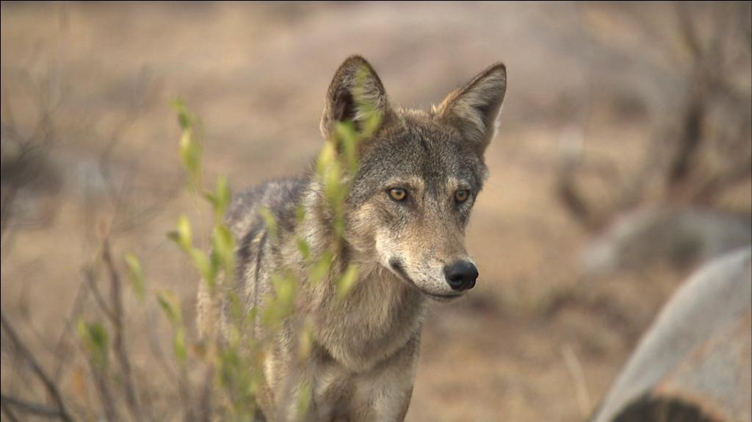

Slide 7
Agrarian Change/Forest Transformation
    Long Indian legacy of dealing with carnivorous animals.
      No long history of state-sponsored projects to eliminate carnivores
      Rulers hunted, helped to expand agriculture
      Use of religious and magical methods to ward off tigers
      Means of self-defence: Avoidance, killing of marauding animals
      Colonial Influence:
      LITTLE EVIDENCE of an IRRECONCILIABLE conflict of existence of tigers and people. YET:
        Tigers to be sacrificed for land revenue
        Curbing of tiger population
        Hunting of predators by white men. Indians NOT allowed firearms
        Getting Indians to eliminate animals WITHOUT firearms
        Conflicts with ANIMAL REARING (goats, sheep) as well as cultivation

Slide 8
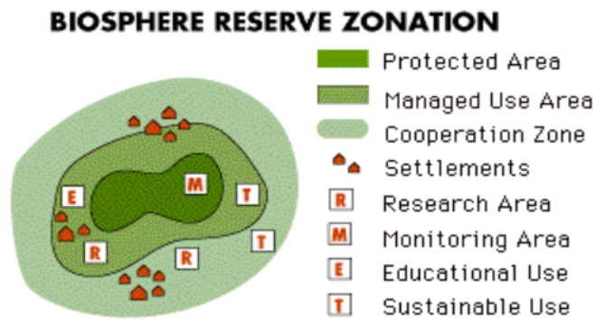

Slide 9
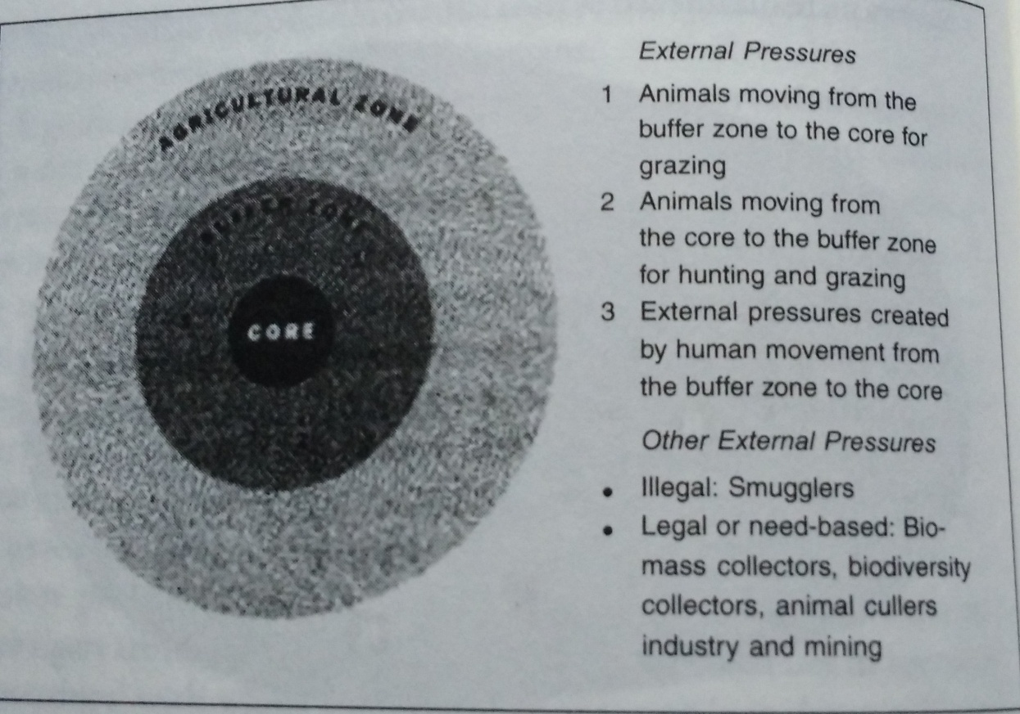
Agrarian Change/Forest Transformation
CONFLICTS:
Reserved forests, CORE areas and human restrictions. Creation of ‘illegal intruders’, ecological refugees.
Dwindling forest space, animal corridors.
Increasing attacks on agricultural produce/cattle.
Changing animal behavior. Read ‘An Elephant Crackup’, NY Times

